Slide 1
Current Trends in Smart Packaging - An Opportunity for Printed Electronics
Prepared by Dominic Cakebread & John Nelson, Smithers Pira for the Centre for Process Innovation (CPI) , Sedgefield 6 October 2015

Slide 2
Agenda
About Smithers Pira
What is ‘Smart Packaging’?
Areas of Current Development
Future Outlook

Slide 3
1. About Smithers Pira
Worldwide authority on the packaging, paper & print Industries
Operate from three Information hubs in the USA and Europe
Work with a global network of associate consultants, interviewers, freelancers & experts
World-wide customer base ranging from printers, paper suppliers, packaging materials suppliers and converters to packaging end-users and brand owners

Slide 4
1. About Smithers Pira
Market Reports
50 market reports on paper, print, packaging & other industrial areas
Consultancy
Bespoke single-client market research and technical consultancy
Conferences
Producer of 20-30 industry conferences each year
Journals & Databases
Journals & online database products
Technical Testing
Laboratories & package testing facilities
Delivering high value market & and technical information enabling you to make better decisions, faster

Slide 5
2. What is Smart Packaging?
“Smart packaging” is an umbrella term for as a range of technologies that allow packaging to contain, evaluate and transmit relevant information.
Generally relates to packaging which senses, records, communicates and/or informs additional to the traditional packaging functions of containment, protection preservation and marketing the product
The objectives of Smart Packaging usually involve:
Extending the shelf-life of the product
Improving product quality and safety
Warning of any potential problems in the product/supply chain
Containing/ transmitting information on product, pack and production history
Since it can perform & improve many different functions in the supply chain, once sensor & communication technology is cheap enough, usage is expected to accelerate

Slide 6
2. What is Smart Packaging?
In a wide sense we define “Smart Packaging” as encompassing the following key technologies:
Indicators & Sensors
Printed Electronics
Communication Systems (Bar & QR Codes)
Tamper Evident Packaging
Anti-counterfeiting & Brand Protection
It differs from “Active Packaging” in that it is usually designed to sense and measure the functions of the packaging and contents but does not to try to adapt to them or control them, such as:
Oxygen scavengers
Ethylene scavengers
Desiccants
Flavour and fragrance emitters
Antimicrobial systems
Source: Smithers Pira

Slide 7
3. Areas of Current Development
Indicators & Sensors
Time/Temperature Sensors (TTIs) - most widespread type , used especially in food & pharma markets.
TTI’s usually based on thermo-chromic inks which can be incorporated in bar codes, based on physical or chemical change
Spoilage indicators (often oxygen indicators) also used to indicate pack integrity is compromised)
Pathogen sensors – being developed for food safety
Many current sensors are too expensive for use in mainstream food packaging, but more widespread for pharma
Companies like Bemis & ThinFilm Electronics developing low cost sensors with rewritable memory to monitor perishable foods
Source: Smithers Pira

Slide 8
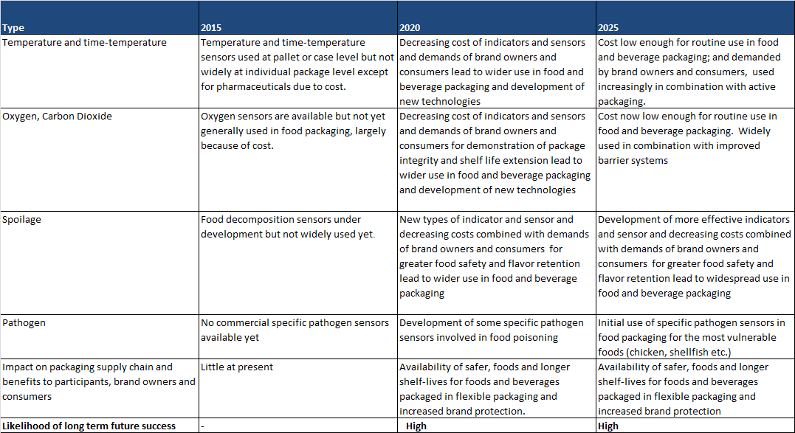
3. Areas of Current Development
Indicators & Sensors
Source: Smithers Pira

Slide 9
3. Areas of Current Development
Printed Electronics
RFID – primary technology driving printed electronics in packaging; currently mainly cheaper passive systems (no battery)
Been used for 20years, but still mainly for logistics control and warehousing, where costs aggregated over larger volume
More and more recent use in consumer packaging, where end-product application justifies it; disposables for heath-care, pharma, CDs
Still too expensive for mainstream consumer food packaging, but costs falling and cheaper printed electronics becoming available
Current growth driven by new less expensive, non toxic materials ranging from electro-luminescent to specific gas sensing & power generating systems
Source: Smithers Pira

Slide 10
3. Areas of Current Development
Printed Electronics
Smaller lighter versions needed for flexible and lighter weight packaging
Can impart significant advantages to brand owner by interacting with consumer
Recent developments focus especially on graphene printed in the form of thin transparent, electrically conductive but also barrier properties. Also boron, tin and molybdenum sulphide
Source: Smithers Pira

Slide 11
3. Areas of Current Development
Communication Systems
Design of Smart Packaging not only requires sensors, indicators, but also means of identification, authentication and communicating information
UPC bar codes are most common form of data carrier, ubiquitous in use due to low cost and simplicity
Increasingly incorporating other technologies (micro-taggants, RFID, thermo-chromic inks etc.), but small data storage capacity is the major limitation;
RFID frequently used for digital temperature loggers thru’ shipment & warehousing
Printed electronics read with NFC (especially QR Codes) present possibility of major changes and cost savings at supermarket checkouts and with all equipment throughout the supply chain (adjusted for weight, size, gauge etc)
QR codes gradually replacing bar codes – more rapid reading, greater storage – though some issues with non-flat surfaces.
Source: Smithers Pira

Slide 12
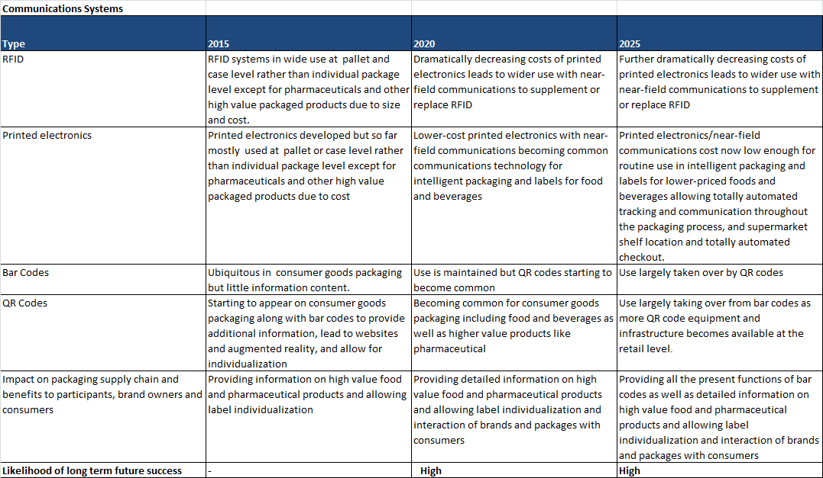
3. Areas of Current Development
Communication Systems
Source: Smithers Pira

Slide 13
3. Areas of Current Development
Tamper Evident Packaging
TE Packaging defined (by FDA) as “having an indicator or barrier to entry, which if breached or missing, can reasonably be expected to provide visible evidence to the consumer that tampering has occurred”
Important and found in widespread usage (especially with closures) in food, beverage, cosmetics and OTC pharma packaging where it is often a legal requirement
TE also evident in flexible packaging (inc. shrink/stretch wrap) –
Some TE labels and seals being developed (eg. Stanelco Pulsline) incorporating uncopyable biocodes, DNA or RFID tags for added security
Whilst TE systems are not in themselves new, increasing use in combination with anti-counterfeiting and printed electronics are taking place
Source: Smithers Pira

Slide 14
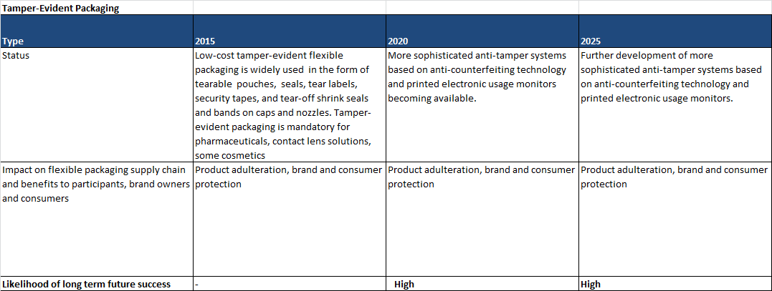
3. Areas of Current Development
Tamper Evident Packaging
Source: Smithers Pira

Slide 15
3. Areas of Current Development
Anti-counterfeiting & Brand Protection
Globally counterfeiting causes enormous costs in terms of money and brand reputation to legitimate manufacturers as well as consumer safety
WHO estimate 8% of medical devices and 10% of pharmaceutical worldwide are counterfeit
In consequence great effort is being put into developing systems to combat this including:
Covert systems – micro-taggants, SmartWater and other inks only visible under UV light, authentication system such micro-sized particles and designs invisible to the human eye.
Overt Systems – e.g. Rollspring Ghost watermark technology embedding in the packaging material, holograms and diffraction patterns for identification and anti-counterfeiting
These systems being developed alongside printed electronics, laser technology and cheaper scanning, to provide better solutions for pharmaceuticals
Source: Smithers Pira

Slide 16
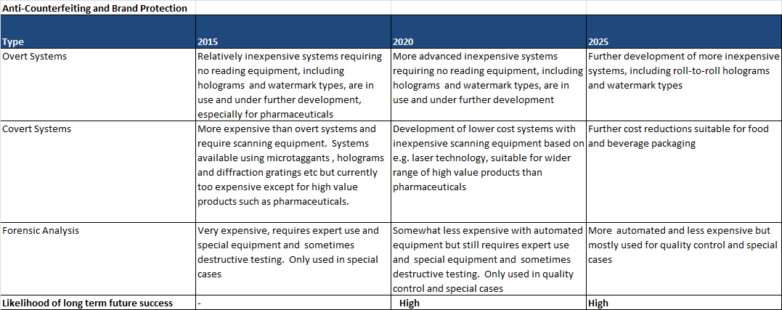
3. Areas of Current Development
Anti-counterfeiting & Brand Protection
Source: Smithers Pira

Slide 17
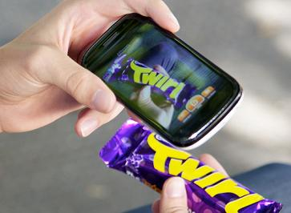
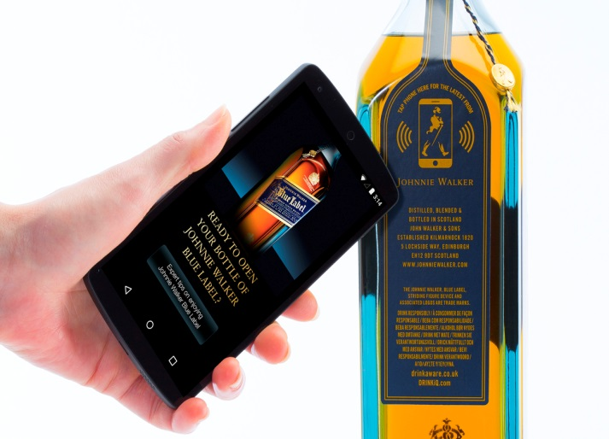
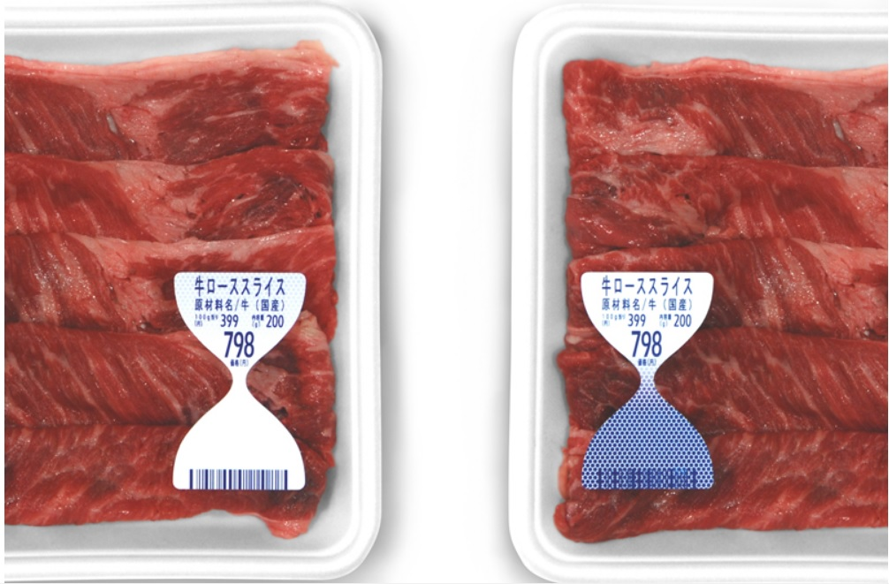
4. Future Outlook
Smart packaging systems can make packaging more informative and interactive. Demand is expected to grow strong to reach US$1.5 billion by 2025
Source: Smithers Pira

Slide 18
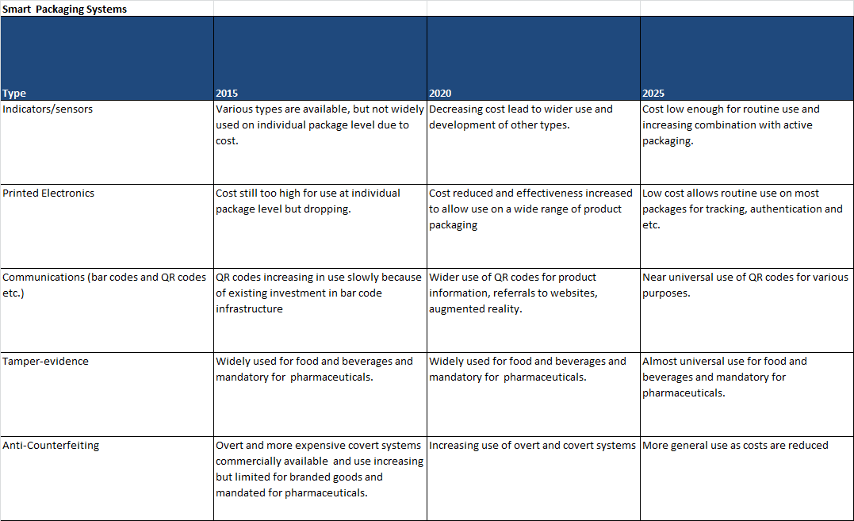
4. Future Outlook
Source: Smithers Pira

Slide 19
4. Future Outlook
Opportunities for Printed Electronics
Market is currently undeveloped for consumer packaging, ripe for development
New technologies offer a wide range of possibilities for improvement in
- supply chain efficiencies
- waste reduction
- product marketing
- consumer engagement/interaction
- added value / functionality
Many new, rapidly advancing technologies are now available; greatest potential in fusing with other Smart & Active packaging technologies
Improving market conditions and falling costs could accelerate market penetration and growth over the next 5-10 years
Source: Smithers Pira

Slide 20
4. Future Outlook
Potential Barriers/ Threats
Greater need for smaller, cheaper systems
Acceptance, adoption & integration thru’ supply chain
Environmental issues and recycling issues
Consumer privacy considerations
Clear understanding of the definitions, boundaries and requirements
Regulatory & legislative environment currently confusing inconsistent, and lags behind the technology growth
Source: Smithers Pira

Slide 21
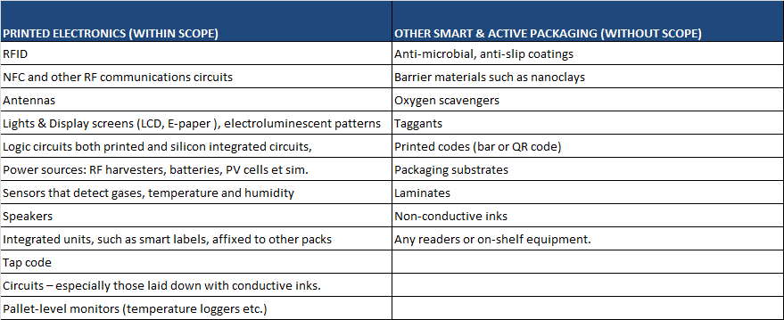
4. Future Outlook
The Current & Future Impact of Legislation on Printed Electronics for Packaging – Specific Definitions
Source: Smithers Pira

Slide 22
Thank you for listening
For further information, please contact:
Dominic Cakebread - Packaging Consultant
Smithers Pira
Leatherhead, United Kingdom
Phone: +44 1372 802020
Email: dcakebread@smithers.com
www.smitherspira.com

